Slide 1
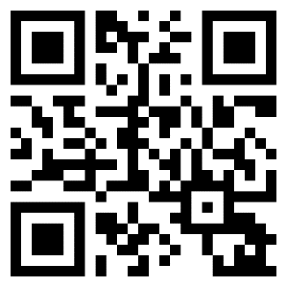
QAnywhere New Prescription Activation
ONLY For New Prescription Activation:
ACTIVATE your new prescriptions via QAnywhere at NHC Patuxent River prior to coming to the pharmacy for pick up.
SCAN ME
OR TEXT
“Get in line” to
1-833-268-5768
When prompted, enter the 10-digit DoD ID for the patient requesting prescriptions.
You will receive a text confirming the patient’s name and date of birth and the option to edit or add an additional patient requesting prescriptions.
You will be assigned a ticket and asked to reply with the name of the medications you would like filled.
Once your prescription is ready, you will receive a text or call notification.
After you receive your ready notification, head to the pharmacy kiosk and select “Return for pick up”.
Take your ticket and wait to be called to the window.
For any questions about your prescription status, please contact the Pharmacy at 301-757-2605, option 1.
Naval Health Clinic Pax River
Pharmacy Info:
Pharmacy Hours:
Monday: 10 a.m. - 3 p.m.
Tuesday-Friday: 8 a.m. - 3 p.m.
Monday-Friday: 3 p.m.-5 p.m. For Pick- up only.
Saturday, Sunday and Federal Holidays: Closed

